Slide 1

UAB Informatics Institute Biocomputing Research Infrastructure and Tools for Omics Data Analysis
Jake Y. Chen, PhD, FACMI, FAIMBE, FAMIA
Professor of Genetics, Computer Science & Biomedical Engineering
Chief Bioinformatics Officer, Informatics Institute
The University of Alabama at Birmingham, USA
jakechen@uab.edu | aimed-lab.org

Slide 2
Schedule
10-10:40am U-BRITE
Jake Y. Chen, PhD, UAB Informatics Institute
Zhandos Sembay, MS, UAB Informatics Institute
10:40-11:40am PAGER
Zongliang Yue, PhD, UAB Informatics Institute
11:40am-noon SEAS (Cohort analysis)
Thanh Nguyen, PhD, Department of Biomedical Engineering

Slide 3
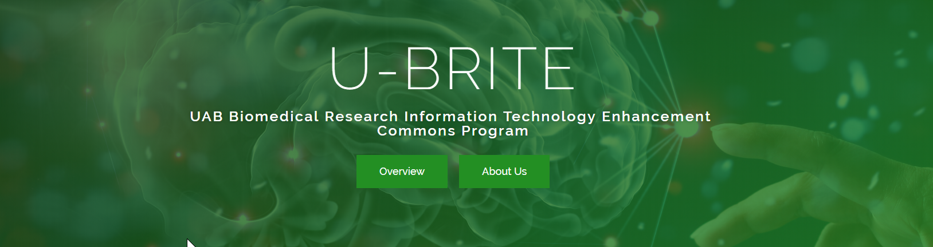
UBRITE: Enabling community-based team data science
U-BRITE is a biomedical data science infrastructure developed at the UAB Informatics Institute to:
Provide HIPAA-compliant, and FAIR-compliant biomedical bioinformatics software tools and APIs on novel research computing infrastructure.
Help researchers better manage and analyze genomic medicine data sets in a new “translational research commons” environment.
Facilitate interdisciplinary research teams to perform “open, virtual science”.

Slide 4
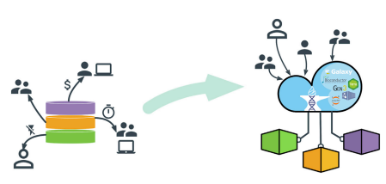
The new paradigm of computing “inverting the model of genomic data access”
DOI:https://doi.org/10.1016/j.xgen.2021.100085

Slide 5
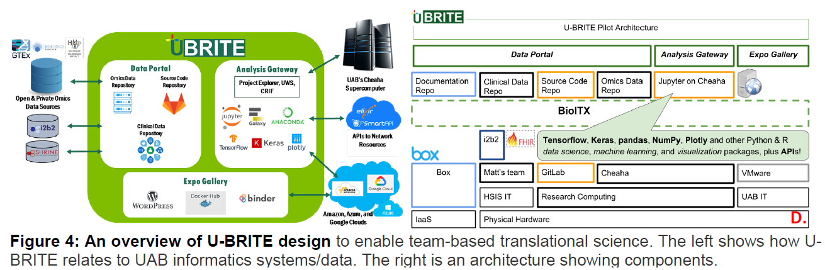
U-BRITE is a community-based team data science platform (http://ubrite.org/)
U-BRITE is a biomedical data science infrastructure developed at the UAB Informatics Institute

Slide 6
UBRITE is a data/analysis/communication commons environment 3-in-1
Community web portal (http://cancer.ubrite.org)
Provide data commons for coding, documentation
Provide analysis commons
Provide workforce training by hosting data science hackathon (http://covid.ubrite.org)
Hosting DREAM challenge contest for AI/ML
Providing Jupyter web notebook based R/python application development
Develop data-driven R-Shiny/Py-Streamlit Web APP

Slide 7
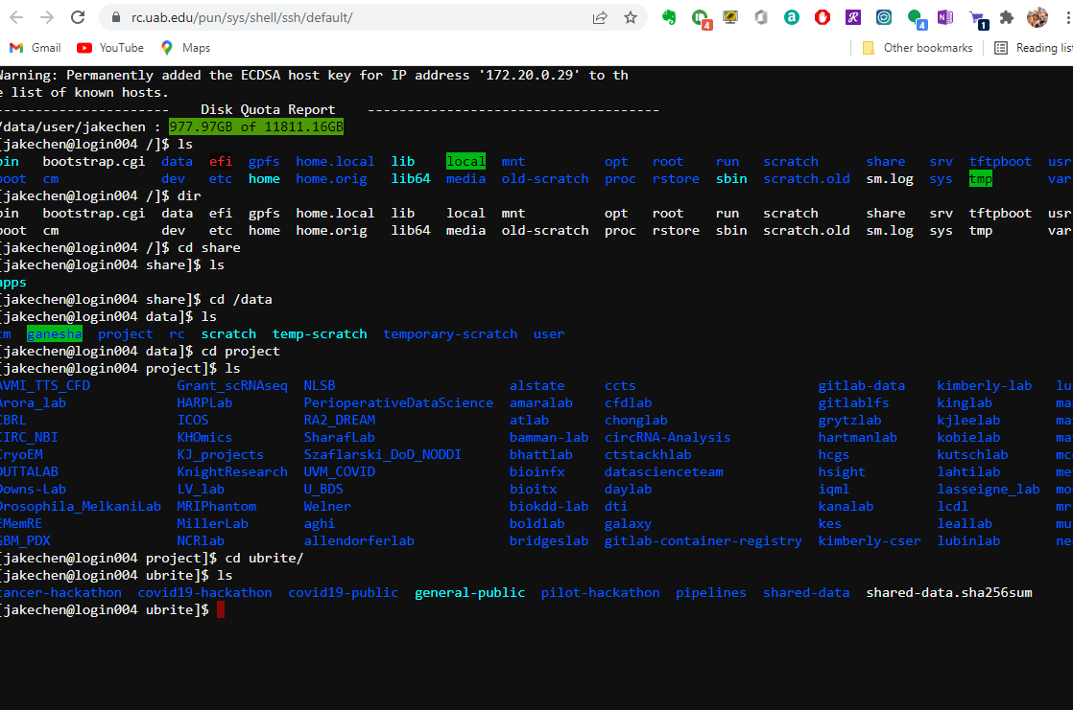
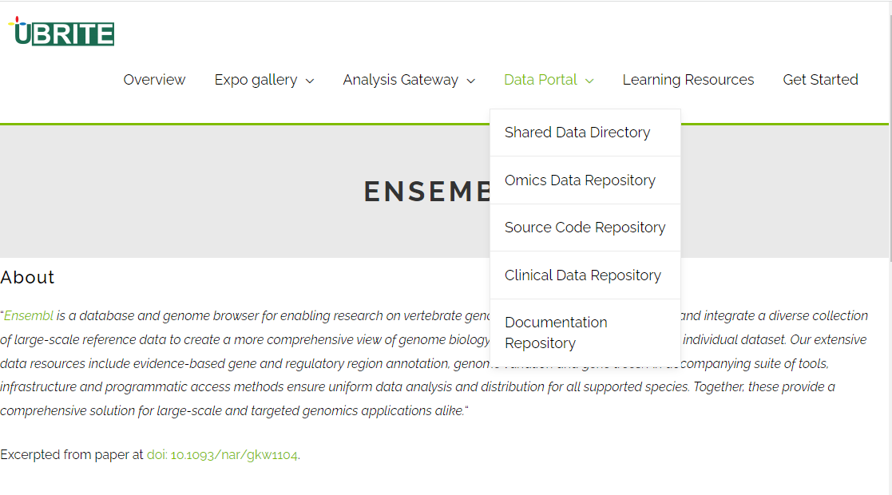
Demo U-BRITE as a team data science gateway to HPC locally at UAB

Slide 8

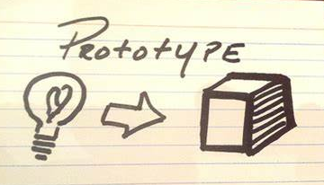



Modern team data science: interdisciplinary, agile, and translational
1. Ideas & Team Formation
2. Prototyping
Feedback,
decomposition, testing, refinement, integration, and redeployment
3. Pilot Studies
5. Real-world Solutions
4. System Building

Slide 9

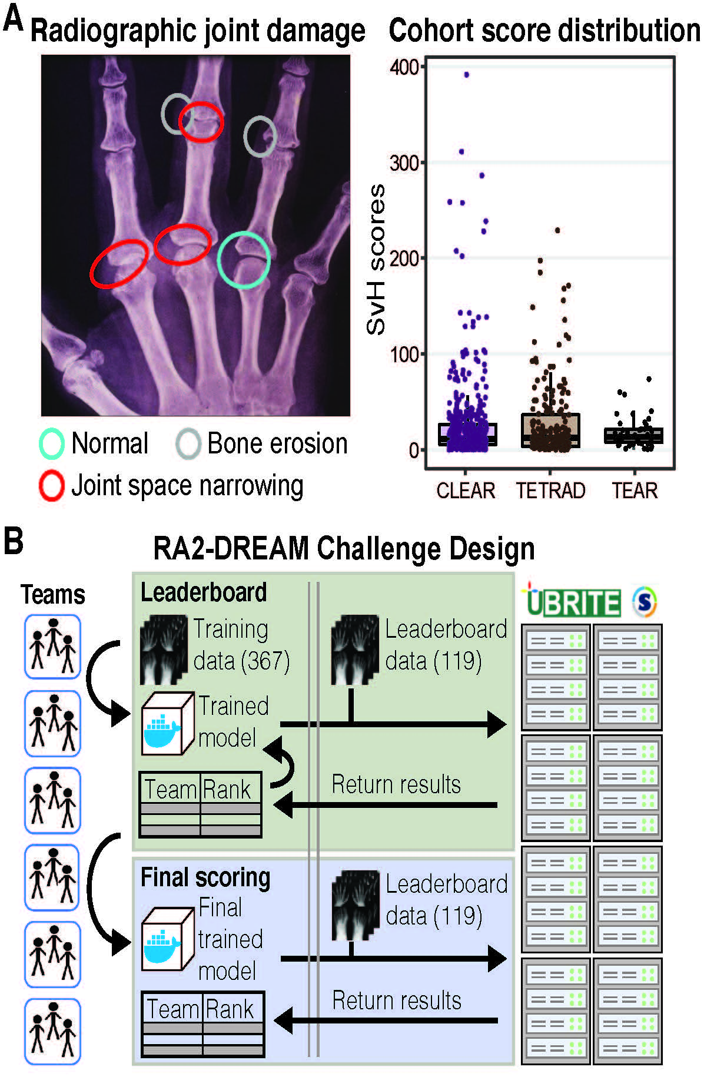
Three sub challenges
# 1: Predict overall RA damage in target joints of the hands and feet
# 2: Predict total joint space narrowing scores in target joints of hands and feet
# 3: Predict joint erosion scores in target joints of hands and feet

Slide 10
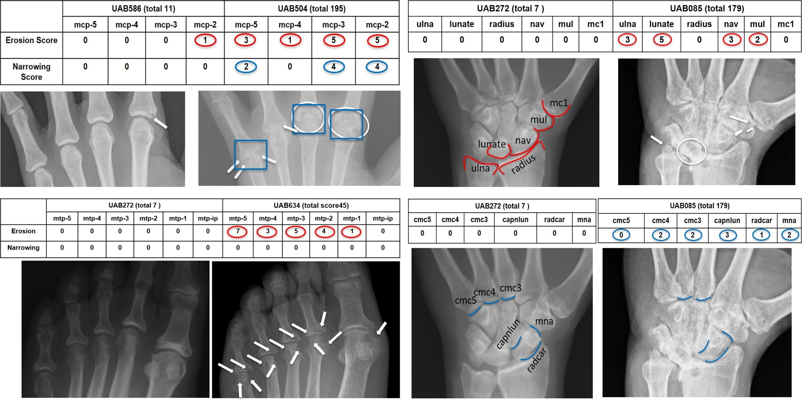
Supplemental Figure

Slide 11
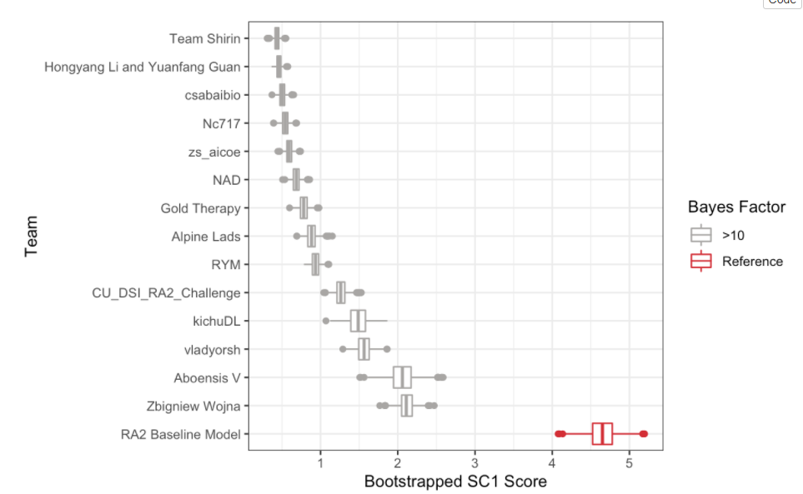
Training Machine Learning and AI models on U-BRITE
Assessing community-submitted AI projects
Test data
(188)
Sub-Challenge #1
…

